Slide 1

50.039 Theory and Practice of Deep Learning W6-S1 Times Series Data and Recurrent Neural Networks
Matthieu De Mari

Slide 2
About this week (Week 6)
XXX

Slide 3
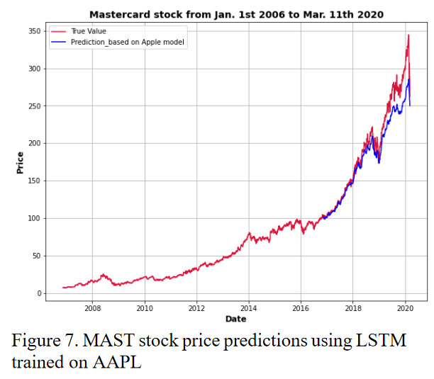
Time series dataset
Definition (time series dataset):
A time series dataset is a sequence of data points that are collected over time, typically at regular intervals.
Time series data can be used to study how a particular variable changes over time, with many applications as
Stock prices,
Weather patterns,
Etc.
Data points are usually ordered chronologically, with each data point representing the value of the variable at a specific point in time.

Slide 4
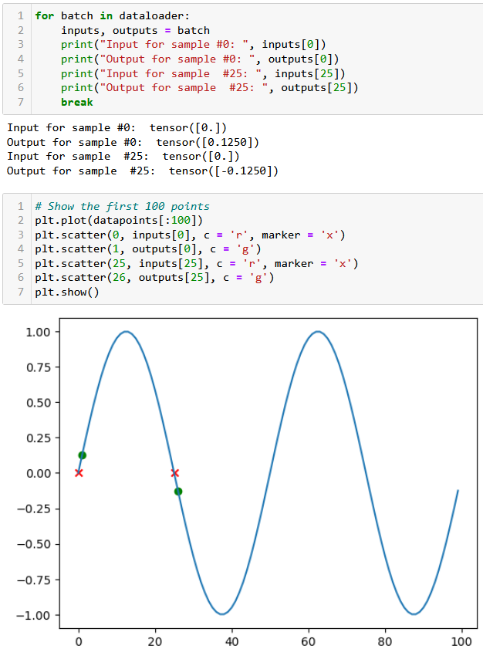
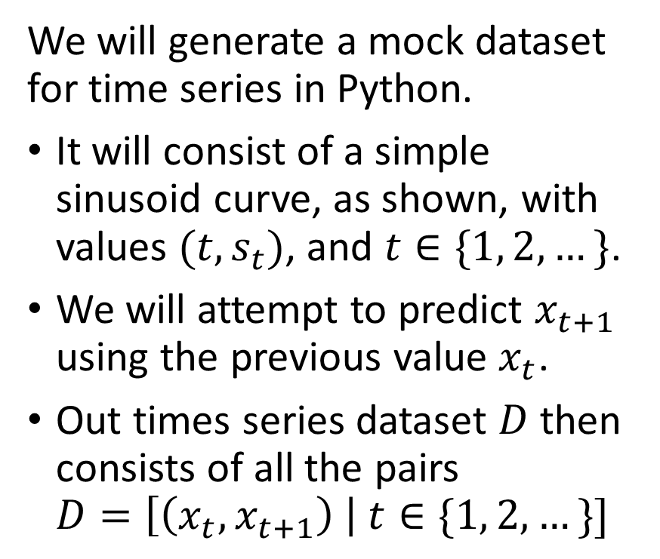
A mock dataset
We will generate a mock dataset for time series in Python.
It will consist of a simple sinusoid curve, as shown, with values $(t,s_{t})$, and $t∈\{1, 2,…\}$.
We will attempt to predict $x_{t+1}$ using the previous value $x_{t}$.
Out times series dataset $D$ then consists of all the pairs $D=\left[\left(x_{t}, x_{t+1}\right) \right| t∈\{1, 2, …\}]$

Slide 5
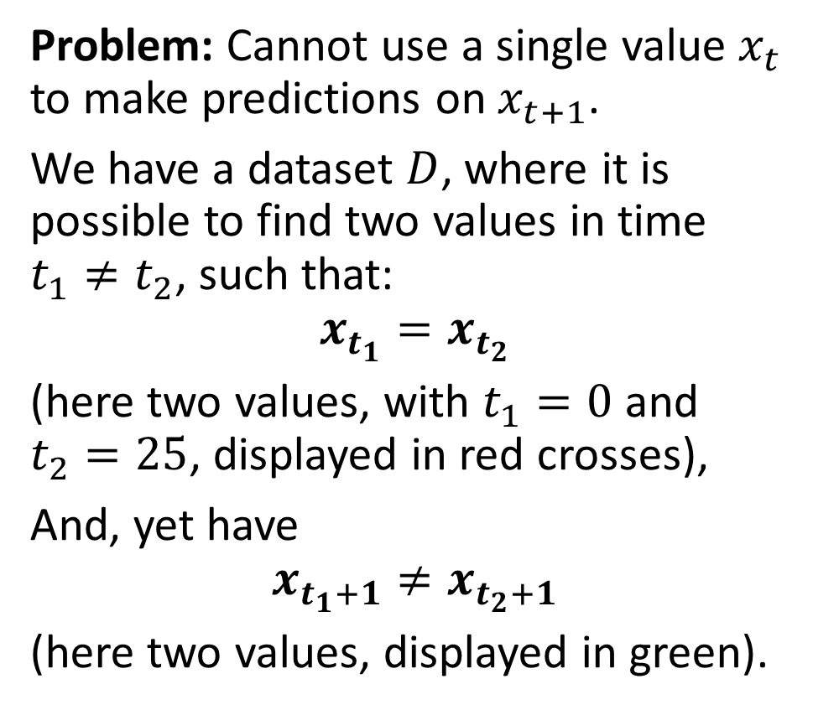
A mock dataset
Problem: Cannot use a single value $x_{t}$ to make predictions on $x_{t+1}$.
We have a dataset $D$, where it is possible to find two values in time $t_{1}≠t_{2}$, such that:
$$x_{t_{1}}=x_{t_{2}}$$ (here two values, with $t_{1}=0$ and $t_{2}=25$, displayed in red crosses),
And, yet have
$$x_{t_{1}+1}≠x_{t_{2}+1}$$
(here two values, displayed in green).

Slide 6
Typical methods for analysing a time series
Typical methods for analysing a time series include
Descriptive statistics: calculating basic summary statistics for the time series (mean, median, variance, etc.). These statistics can provide insights into the central tendency, variability, and distribution of the data.
Visual inspection: Plotting the time series data helps identify patterns, trends, and outliers in the data.

Slide 7
Typical methods for analysing a time series
Decomposition: Time series data often exhibit trends, seasonal patterns, and irregular fluctuations.
Decomposition is a method for separating these components and analysing them separately
Common methods for decomposition include additive and multiplicative decomposition.
(These are out-of-scope.)

Slide 8
A quick word about decomposition
Decomposition separates the time series data into different components that capture distinct aspects of the data, expressing it as the sum of several underlying components, each with its own distinct pattern, e.g.:
Trend: This component represents the long-term changes or fluctuations in the data over time. It is typically modelled as a smooth curve that captures the overall direction of the time series.
Seasonal: This component captures the regular, periodic fluctuations in the data that occur over fixed periods of time, such as daily, weekly, or monthly. It is often modelled as a set of repeating patterns that correspond to the seasonal cycles.
Residual: This component represents the random or irregular fluctuations in the data that are not explained by the trend or seasonal components. It is often modelled as a series of random noise or white noise.

Slide 9
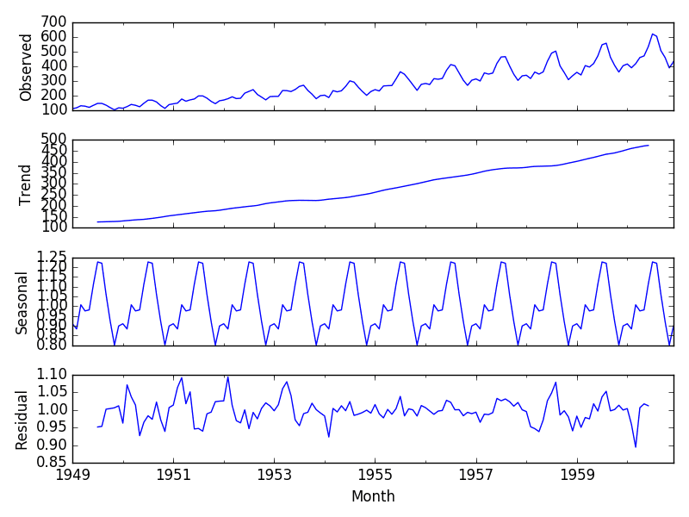
A quick word about decomposition
Decomposition separates a time series into trend (long-term changes), seasonal (periodic fluctuations), and residual (random fluctuations) components.
Trend is a smooth curve, seasonal is a set of repeating patterns, and residual is a series of random noise.

Slide 10
Typical methods for analysing a time series
Decomposition: Time series data often exhibit trends, seasonal patterns, and irregular fluctuations.
Decomposition is a method for separating these components and analysing them separately
Common methods for decomposition include additive and multiplicative decomposition.
(These are out-of-scope.)

Slide 11
Typical methods for analysing a time series
Time series models: Statistical models used to describe the underlying processes that generate the time series data.
Time series models can be used for forecasting future values, identifying important predictors, and understanding the relationships among variables.
ML models: autoregressive integrated moving average (ARIMA) models, exponential smoothing models, state space models, etc.
(These are out-of-scope.)

Slide 12
Typical methods for analysing a time series
Time series models: Statistical models used to describe the underlying processes that generate the time series data.
Time series models can be used for forecasting future values, identifying important predictors, and understanding the relationships among variables.
DL models: using neural networks as predictors, to predict the next value for a time series variable given a history as input.
(to be investigated!)

Slide 13
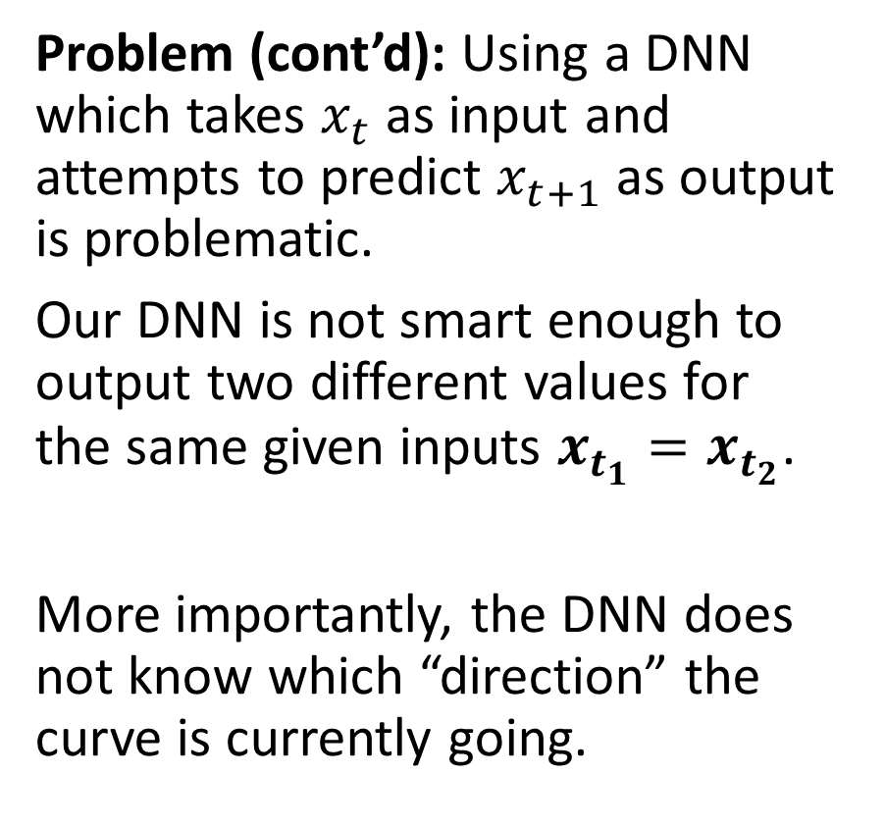
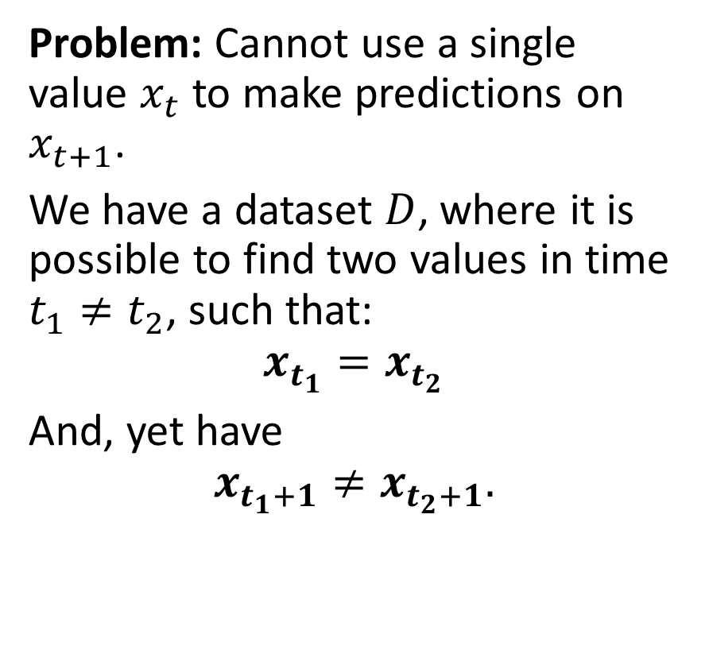
Using a simple DNN to predict
Problem: Cannot use a single value $x_{t}$ to make predictions on $x_{t+1}$.
We have a dataset $D$, where it is possible to find two values in time $t_{1}≠t_{2}$, such that:
$$x_{t_{1}}=x_{t_{2}}$$ And, yet have
$$x_{t_{1}+1}≠x_{t_{2}+1}.$$
Problem (cont’d): Using a DNN which takes $x_{t}$ as input and attempts to predict $x_{t+1}$ as output is problematic.
Our DNN is not smart enough to output two different values for the same given inputs $x_{t_{1}}=x_{t_{2}}$.
More importantly, the DNN does not know which “direction” the curve is currently going.

Slide 14
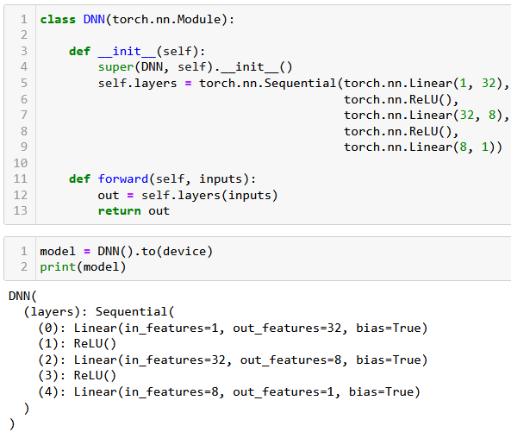
Using a simple DNN to predict
Try it, anyway: Let us try and define a simple DNN:
3 Linear Layers + ReLU,
No ReLU on final layer,
Number of inputs = 1,
Number of outputs = 1,
Hidden layers sizes: 32 and 8.

Slide 15
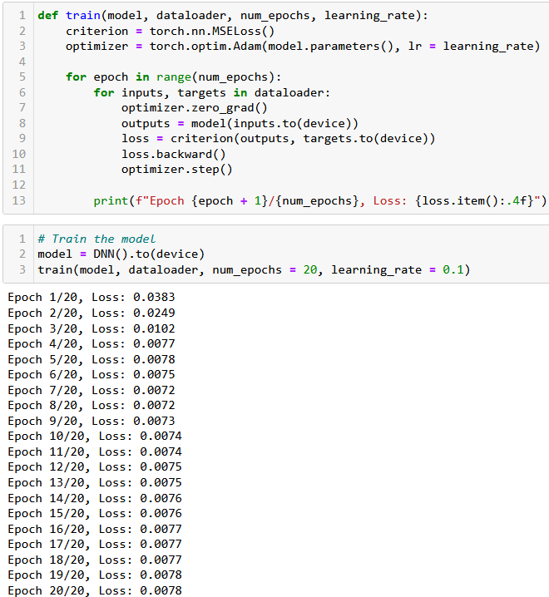
Using a simple DNN to predict
Try it, anyway: Let us try and define a simple DNN:
3 Linear Layers + ReLU,
No ReLU on final layer,
Number of inputs = 1,
Number of outputs = 1,
Hidden layers sizes: 32 and 8.
Simple trainer function, and seems to train, but is it good?

Slide 16
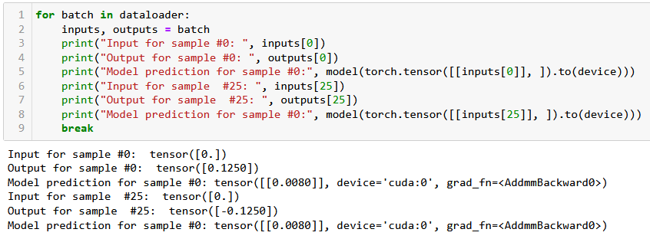

Using a simple DNN to predict
This low loss obtained after training does not mean much…
Thee model is not capable of learning to predict correctly: it is not smart enough to output two different values for the same given inputs $x_{t_{1}}=x_{t_{2}}$.
Also, it needs to know which “direction” the curve is currently going.

Slide 17
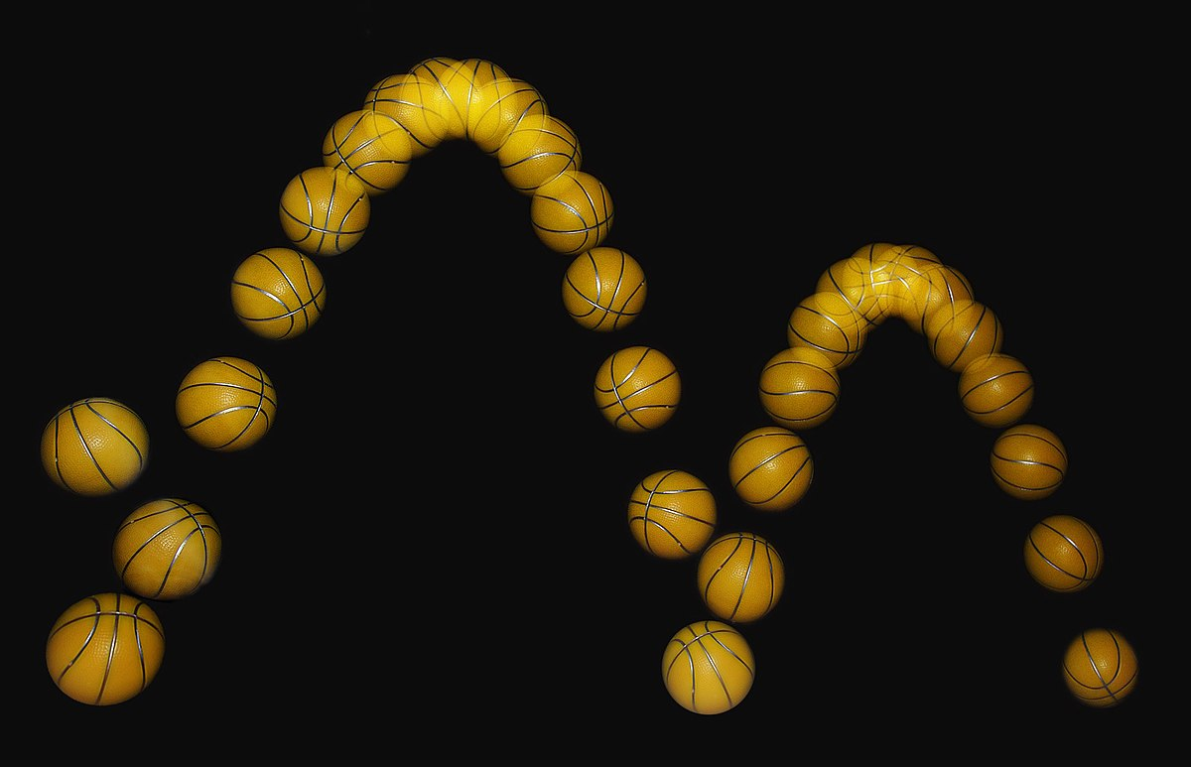
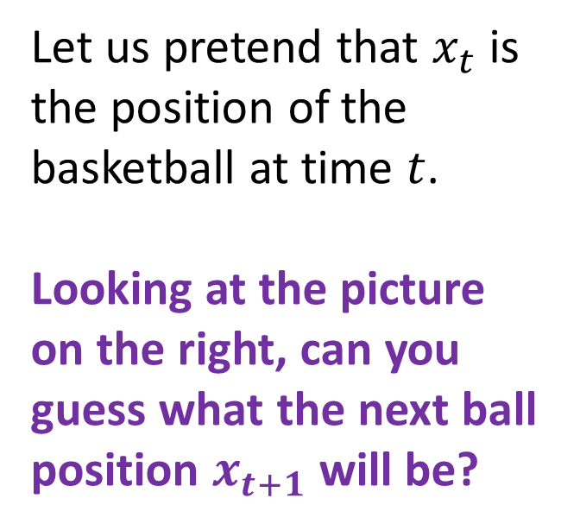
A visual example for the need of “direction”
Let us pretend that $x_{t}$ is the position of the basketball at time $t$.
Looking at the picture on the right, can you guess what the next ball position $x_{t+1}$ will be?
????

Slide 18
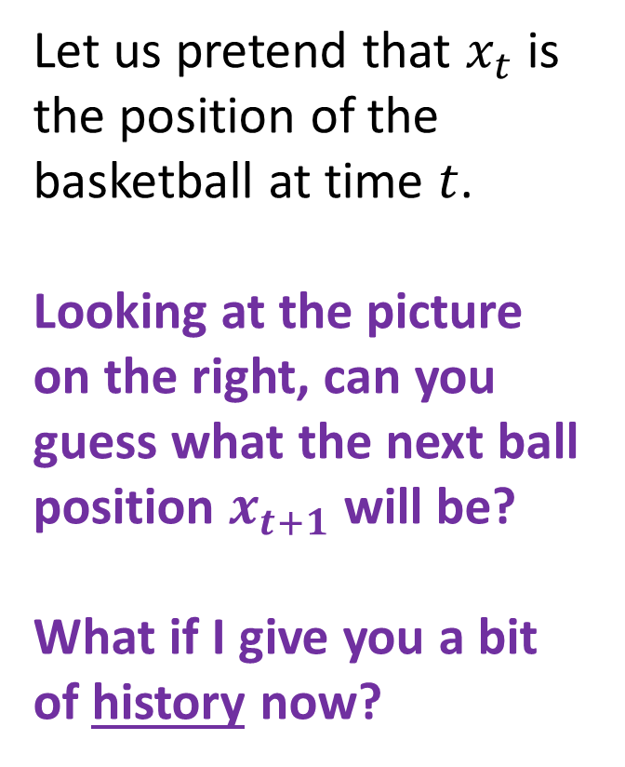
A visual example for the need of “direction”
Let us pretend that $x_{t}$ is the position of the basketball at time $t$.
Looking at the picture on the right, can you guess what the next ball position $x_{t+1}$ will be?
What if I give you a bit of history now?

Slide 19
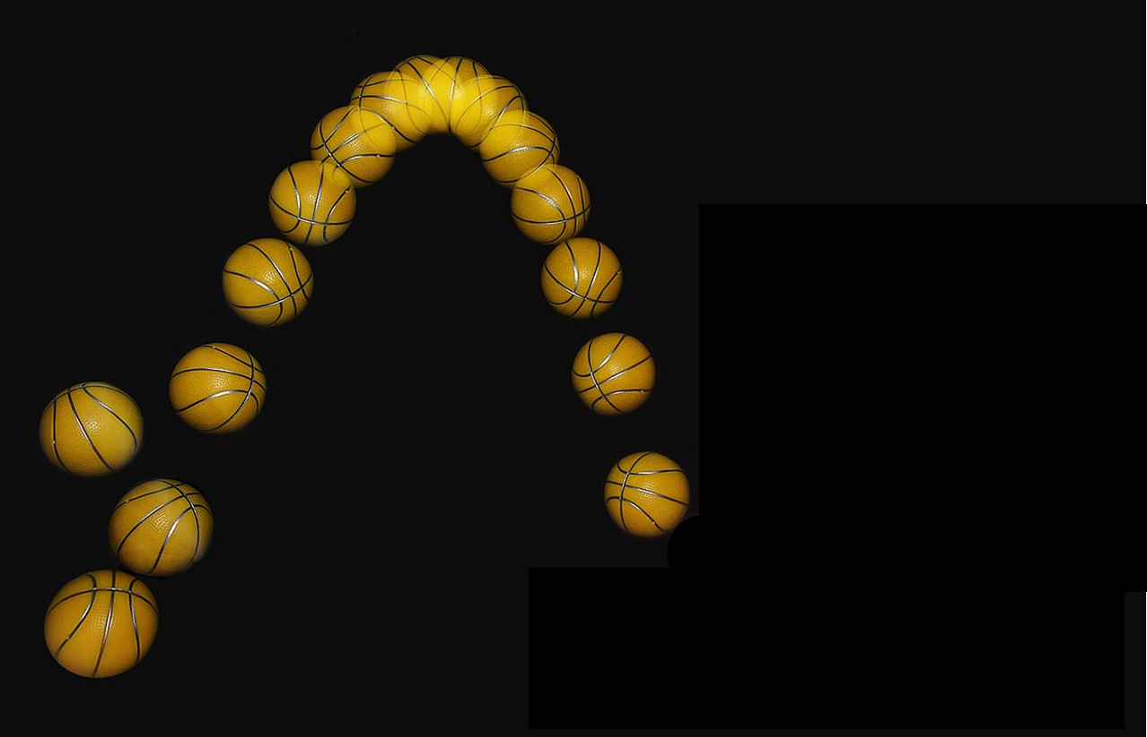
A visual example for the need of “direction”
Definition (history):
History refers to the past observations or values of the time series up to a certain point in time.
It provides information about the patterns and trends of the data over time, which can be used to make predictions and identify important factors that influence the time series.
E.g., predicting a stock price, requires to know the history of the stock prices, as past values of the stock prices can provide important information about the trend and volatility of the stock.

Slide 20
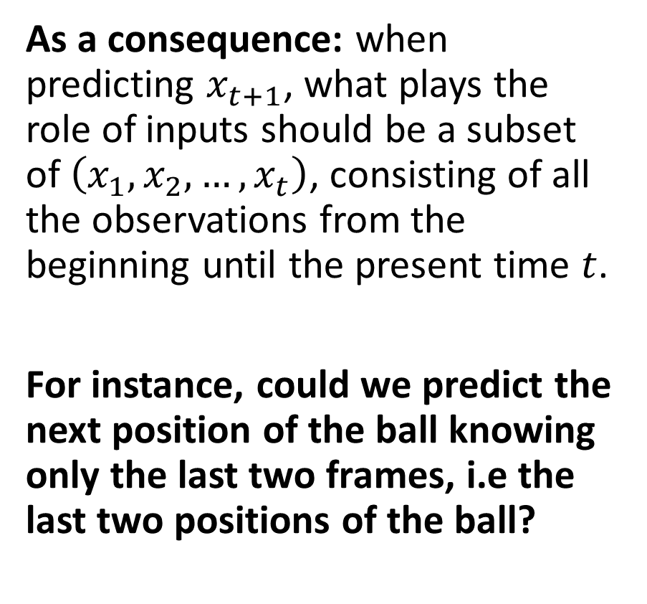
A visual example for the need of “direction”
As a consequence: when predicting $x_{t+1}$, what plays the role of inputs should be a subset of $\left(x_{1}, x_{2}, …, x_{t}\right)$, consisting of all the observations from the beginning until the present time $t$.
For instance, could we predict the next position of the ball knowing only the last two frames, i.e the last two positions of the ball?

Slide 21
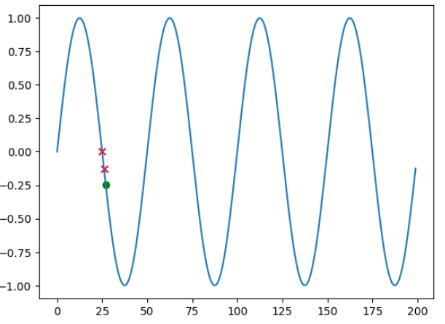
Reworking the Dataset a bit
Definition (lookback size):
The number of past observations or values of a time series that are used to make a prediction is commonly referred to as the "lookback" or "window" size.
It is the length of the history that is used to inform the prediction of the next value in the time series.
In our example, the lookback size is simply 2.

Slide 22
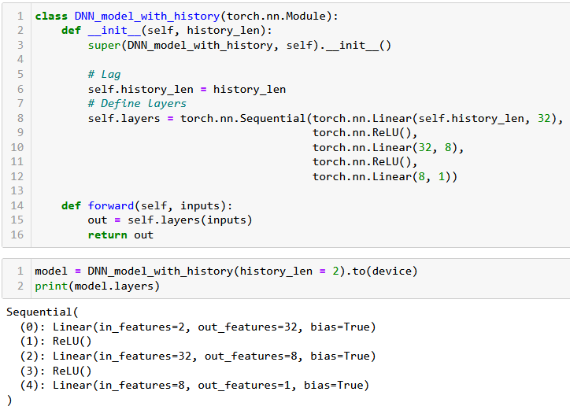
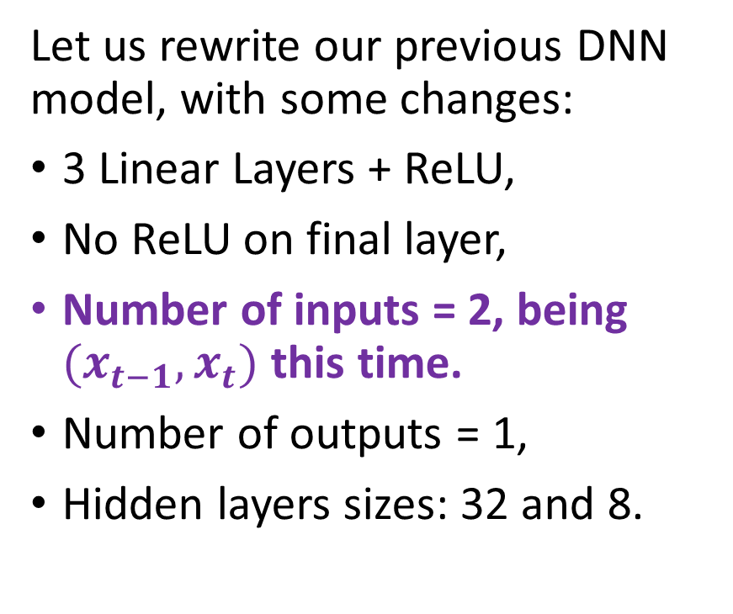
Using a simple DNN to predict
Let us rewrite our previous DNN model, with some changes:
3 Linear Layers + ReLU,
No ReLU on final layer,
Number of inputs = 2, being $(x_{t−1}, x_{t})$ this time.
Number of outputs = 1,
Hidden layers sizes: 32 and 8.

Slide 23
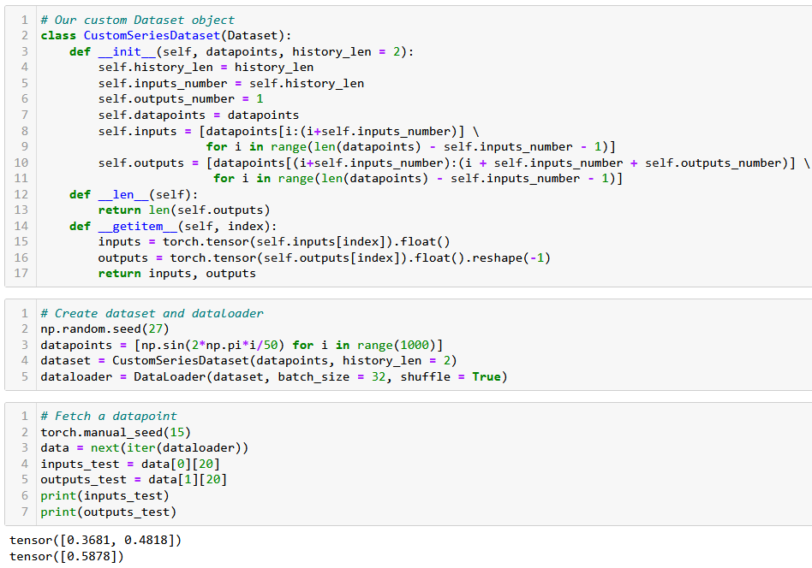
Reworking the Dataset to include history

Slide 24
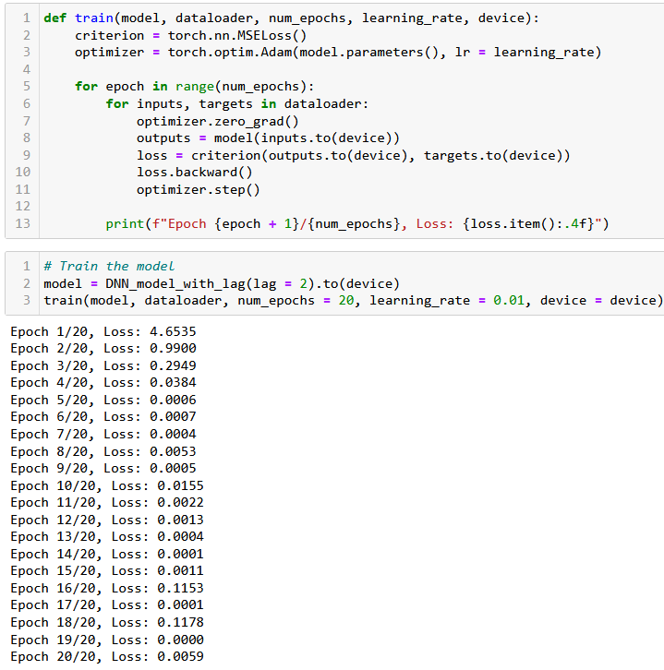
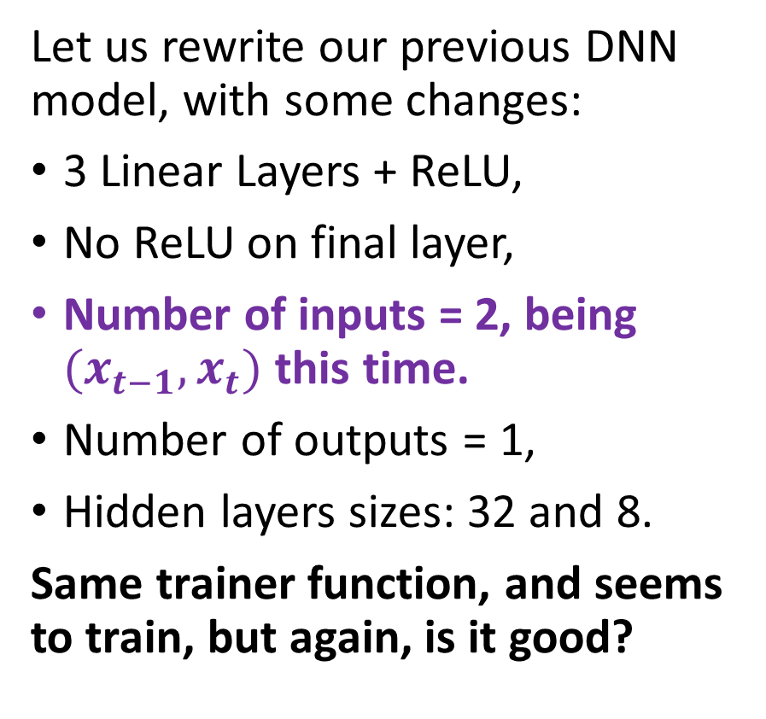
Using a simple DNN to predict
Let us rewrite our previous DNN model, with some changes:
3 Linear Layers + ReLU,
No ReLU on final layer,
Number of inputs = 2, being $(x_{t−1}, x_{t})$ this time.
Number of outputs = 1,
Hidden layers sizes: 32 and 8.
Same trainer function, and seems to train, but again, is it good?

Slide 25
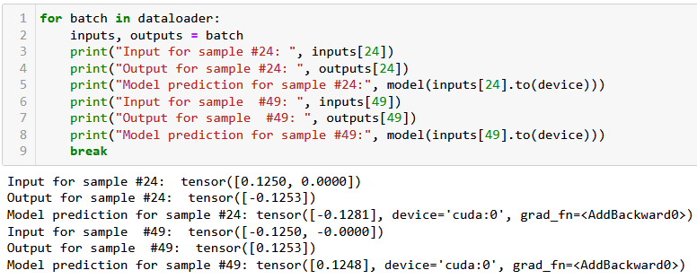

Using a simple DNN to predict
This time the predictor works, as we obtain the correct prediction values.
In the example below, we had $x_{t_{1}}=x_{t_{2}}$, but $x_{t_{1}−1}≠x_{t_{2}−1}$.
This was good enough to help the DNN formulate good predictions now.

Slide 26
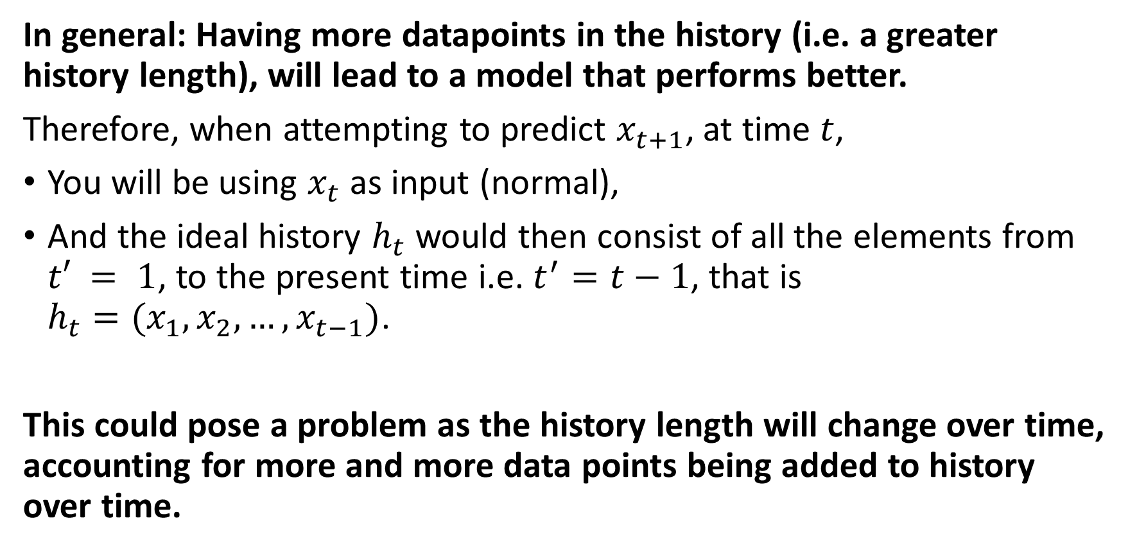
What is a good history length then?
In general: Having more datapoints in the history (i.e. a greater history length), will lead to a model that performs better.
Therefore, when attempting to predict $x_{t+1}$, at time $t$,
You will be using $x_{t}$ as input (normal),
And the ideal history $h_{t}$ would then consist of all the elements from $t′ = 1$, to the present time i.e. $t^{′}=t−1$, that is $h_{t}=(x_{1}, x_{2}, …, x_{t−1})$.
This could pose a problem as the history length will change over time, accounting for more and more data points being added to history over time.

Slide 27
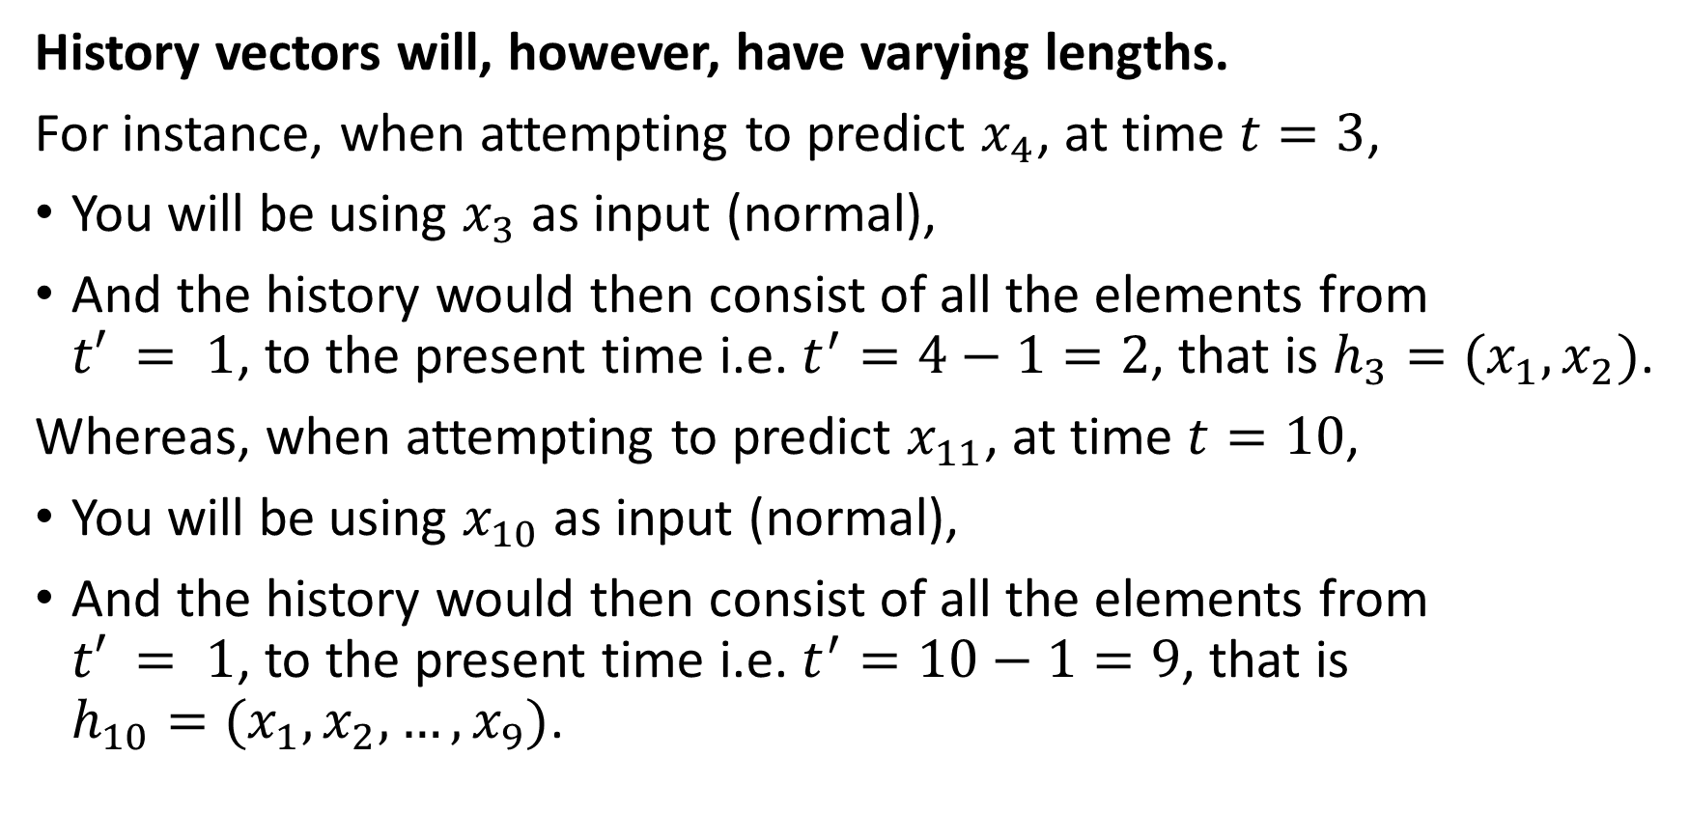
The problem of varying length
History vectors will, however, have varying lengths.
For instance, when attempting to predict $x_{4}$, at time $t=3$,
You will be using $x_{3}$ as input (normal),
And the history would then consist of all the elements from $t′ = 1$, to the present time i.e. $t^{′}=4−1=2$, that is $h_{3}=(x_{1}, x_{2})$.
Whereas, when attempting to predict $x_{11}$, at time $t=10$,
You will be using $x_{10}$ as input (normal),
And the history would then consist of all the elements from $t′ = 1$, to the present time i.e. $t^{′}=10−1=9$, that is $h_{10}=(x_{1},x_{2},…, x_{9})$.

Slide 28
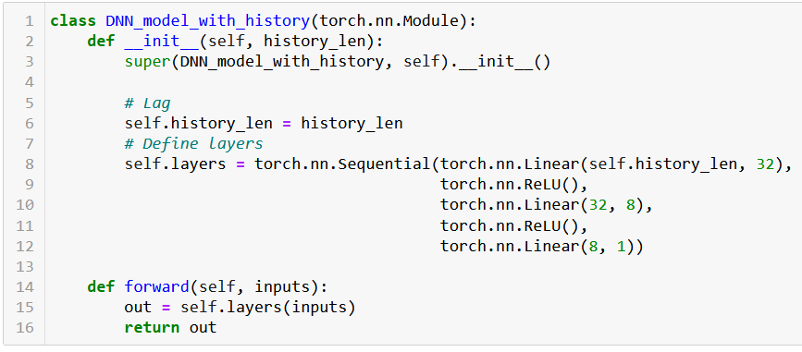
The problem of varying length
Variable history length can be a problem in our current neural network implementation because it requires fixed-length input sequences.

Slide 29
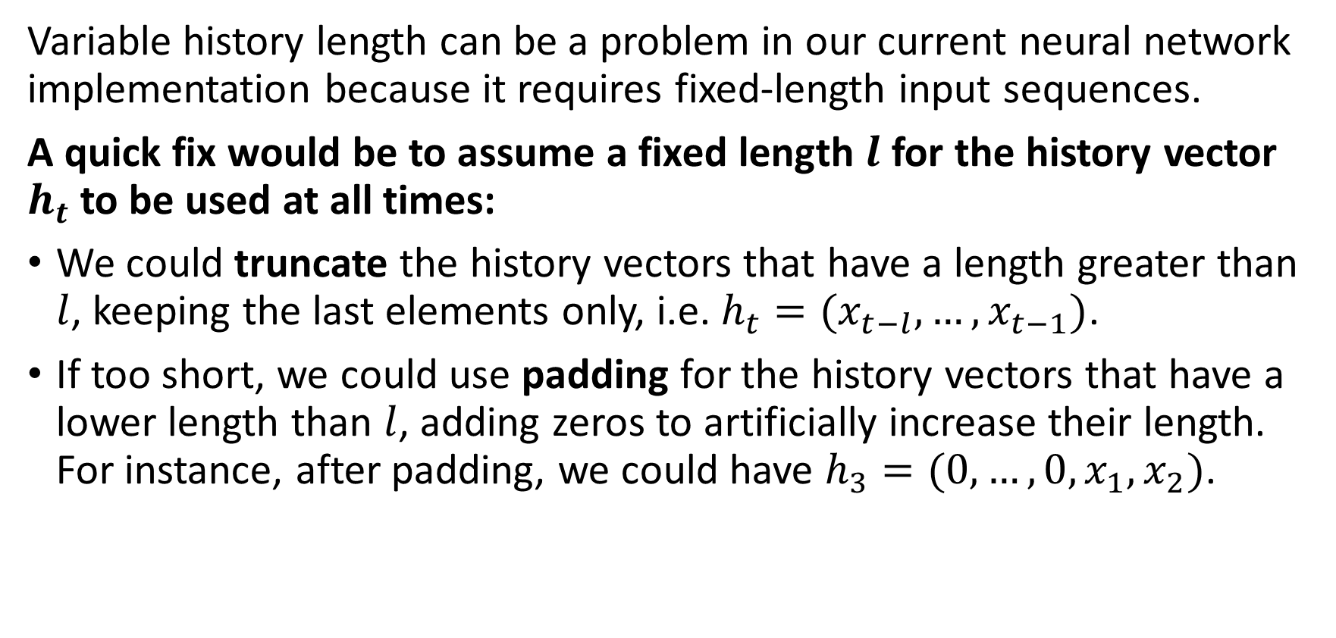
The problem of varying length
Variable history length can be a problem in our current neural network implementation because it requires fixed-length input sequences.
A quick fix would be to assume a fixed length $l$ for the history vector $h_{t}$to be used at all times:
We could truncate the history vectors that have a length greater than $l$, keeping the last elements only, i.e. $h_{t}=(x_{t−l},…,x_{t−1})$.
If too short, we could use padding for the history vectors that have a lower length than $l$, adding zeros to artificially increase their length. For instance, after padding, we could have $h_{3}=(0, …, 0, x_{1}, x_{2})$.

Slide 30
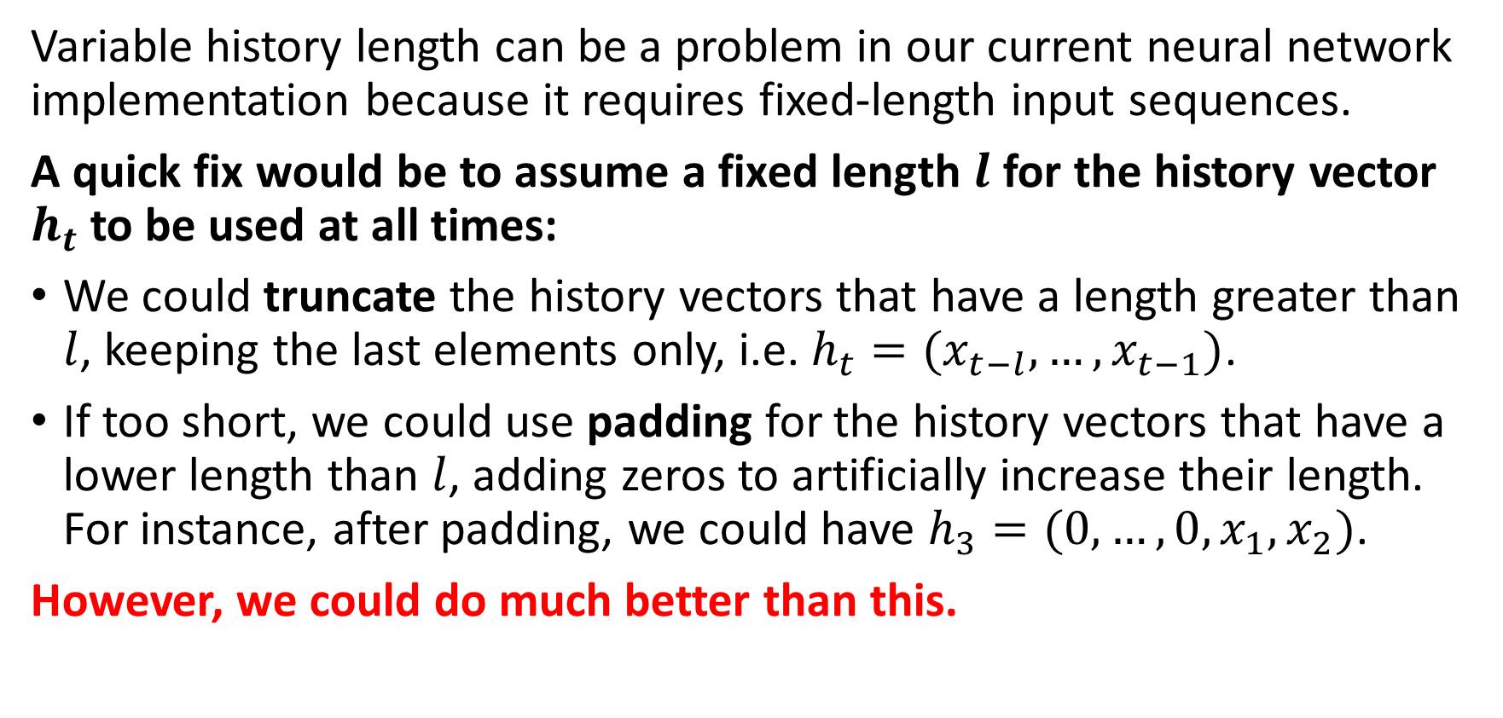
The problem of varying length
Variable history length can be a problem in our current neural network implementation because it requires fixed-length input sequences.
A quick fix would be to assume a fixed length $l$ for the history vector $h_{t}$to be used at all times:
We could truncate the history vectors that have a length greater than $l$, keeping the last elements only, i.e. $h_{t}=(x_{t−l},…,x_{t−1})$.
If too short, we could use padding for the history vectors that have a lower length than $l$, adding zeros to artificially increase their length. For instance, after padding, we could have $h_{3}=(0, …, 0, x_{1}, x_{2})$.
However, we could do much better than this.

Slide 31
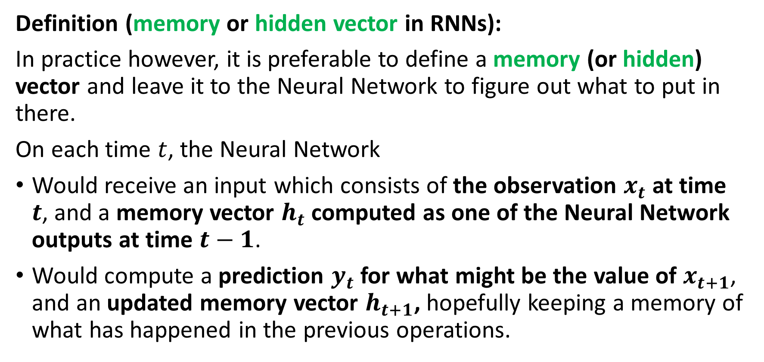
The need for memory
Definition (memory or hidden vector in RNNs):
In practice however, it is preferable to define a memory (or hidden) vector and leave it to the Neural Network to figure out what to put in there.
On each time $t$, the Neural Network
Would receive an input which consists of the observation $x_{t}$ at time $t$, and a memory vector $h_{t}$ computed as one of the Neural Network outputs at time $t−1$.
Would compute a prediction $y_{t}$ for what might be the value of $x_{t+1}$, and an updated memory vector $h_{t+1}$, hopefully keeping a memory of what has happened in the previous operations.

Slide 32


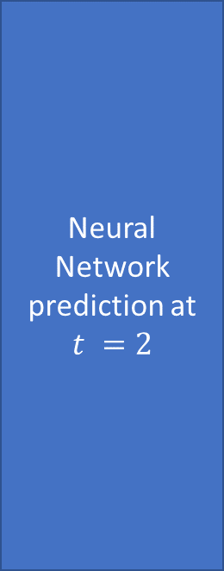
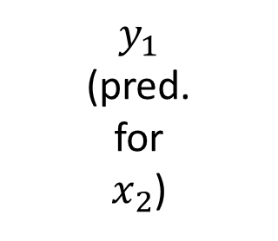

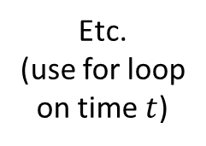



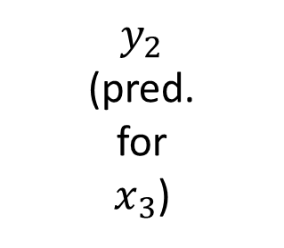
The need for memory
Neural Network prediction at $t = 1$
$$y_{1}$$
(pred. for $x_{2}$)
Neural Network prediction at $t =2$
$$y_{2}$$
(pred. for $x_{3}$)
$$x_{1}$$
$$x_{2}$$
Etc.
(use for loop on time $t$)
$$h_{0}=zeros(l)$$
$$h_{1}$$
$$h_{2}$$

Slide 33
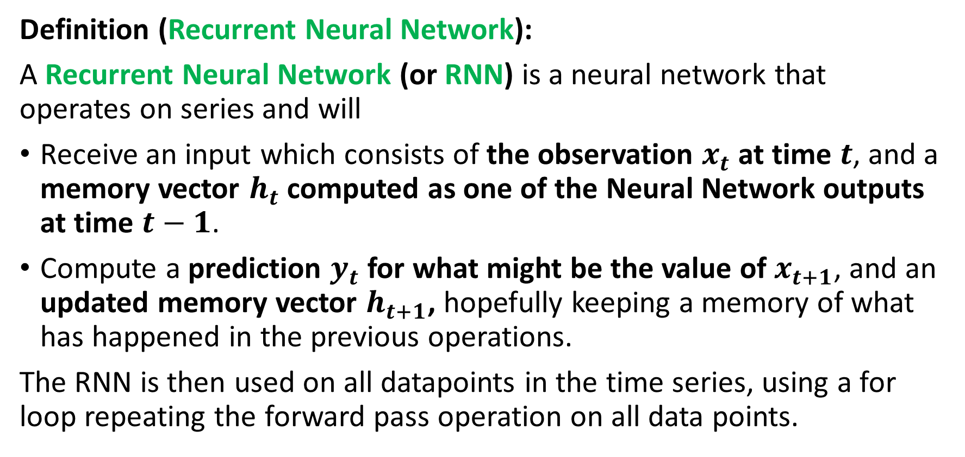
Defining a Recurrent Neural Network (RNN)
Definition (Recurrent Neural Network):
A Recurrent Neural Network (or RNN) is a neural network that operates on series and will
Receive an input which consists of the observation $x_{t}$ at time $t$, and a memory vector $h_{t}$ computed as one of the Neural Network outputs at time $t−1$.
Compute a prediction $y_{t}$ for what might be the value of $x_{t+1}$, and an updated memory vector $h_{t+1}$, hopefully keeping a memory of what has happened in the previous operations.
The RNN is then used on all datapoints in the time series, using a for loop repeating the forward pass operation on all data points.

Slide 34
The need for memory
Neural Network prediction at $t = 1$
$$y_{1}$$
(pred. for $x_{2}$)
Neural Network prediction at $t =2$
$$y_{2}$$
(pred. for $x_{3}$)
$$x_{1}$$
$$x_{2}$$
Etc.
(use for loop on time $t$)
$$h_{0}=zeros(l)$$
$$h_{1}$$
$$h_{2}$$

Slide 35
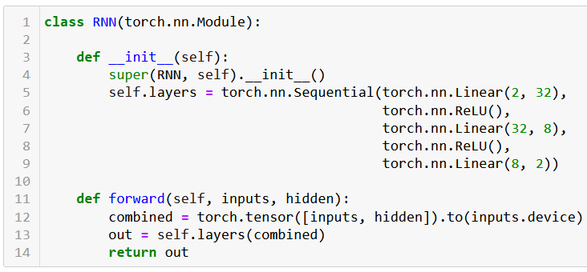
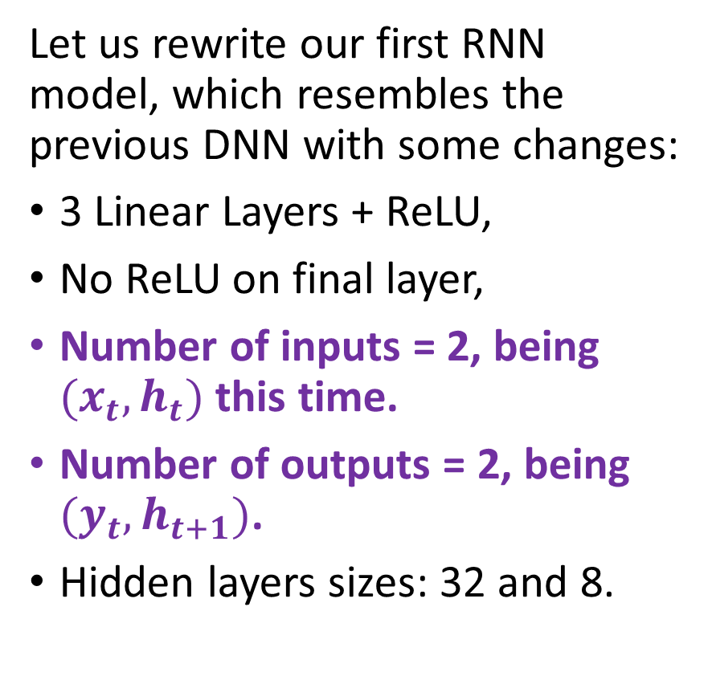
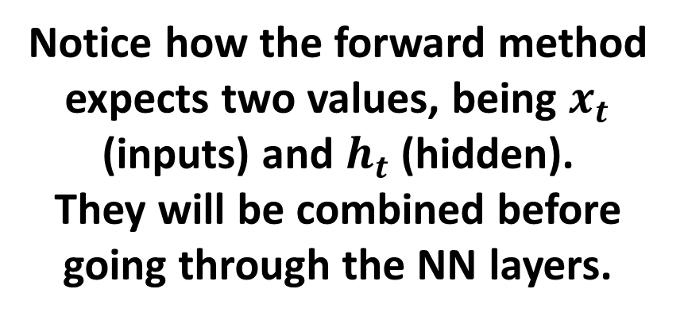
Implementing a RNN
Let us rewrite our first RNN model, which resembles the previous DNN with some changes:
3 Linear Layers + ReLU,
No ReLU on final layer,
Number of inputs = 2, being $(x_{t},h_{t})$ this time.
Number of outputs = 2, being $(y_{t}, h_{t+1})$.
Hidden layers sizes: 32 and 8.
Notice how the forward method expects two values, being $x_{t}$ (inputs) and $h_{t}$ (hidden).
They will be combined before going through the NN layers.

Slide 36
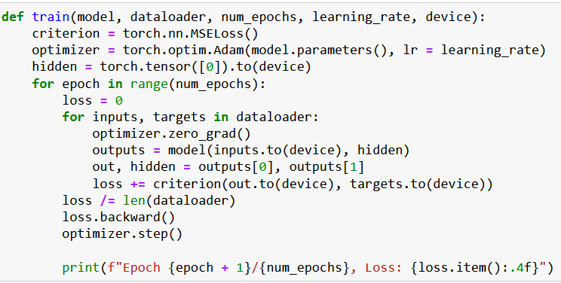
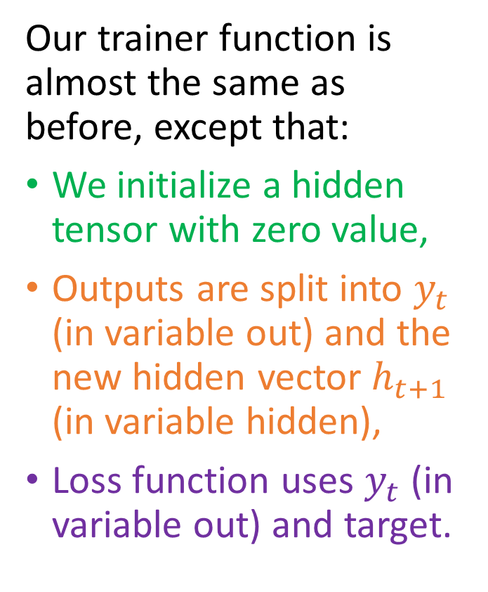
Implementing a RNN
Our trainer function is almost the same as before, except that:
We initialize a hidden tensor with zero value,
Outputs are split into $y_{t}$ (in variable out) and the new hidden vector $h_{t+1}$ (in variable hidden),
Loss function uses $y_{t}$ (in variable out) and target.

Slide 37
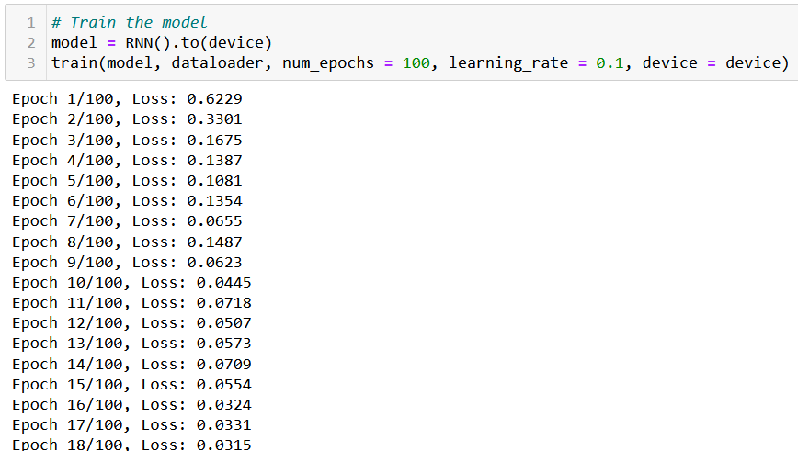
It trains!

Slide 38
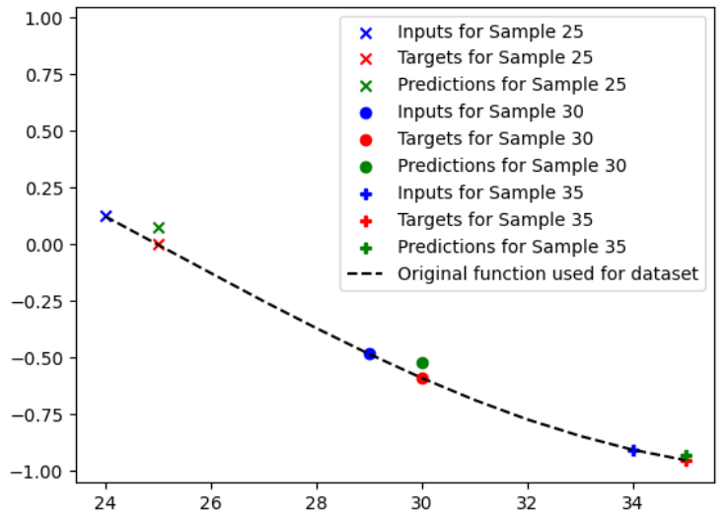
And it is not too bad at predicting!

Slide 39
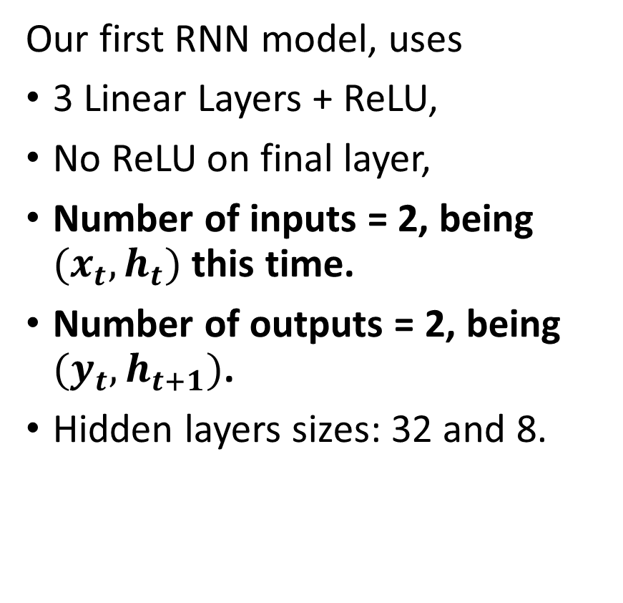
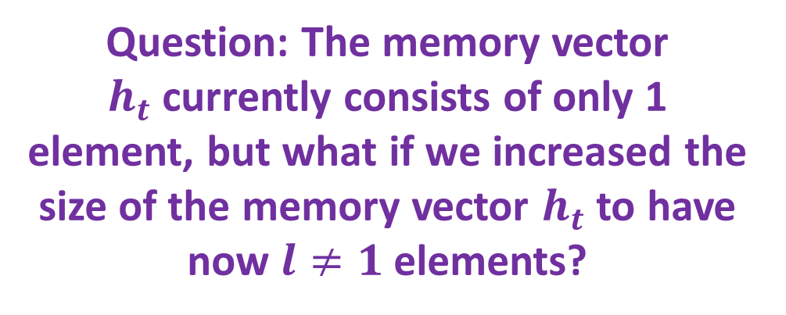
Improving our RNN
Our first RNN model, uses
3 Linear Layers + ReLU,
No ReLU on final layer,
Number of inputs = 2, being $(x_{t},h_{t})$ this time.
Number of outputs = 2, being $(y_{t}, h_{t+1})$.
Hidden layers sizes: 32 and 8.
Question: The memory vector $h_{t}$currently consists of only 1 element, but what if we increased the size of the memory vector $h_{t}$ to have now $l≠1$ elements?

Slide 40
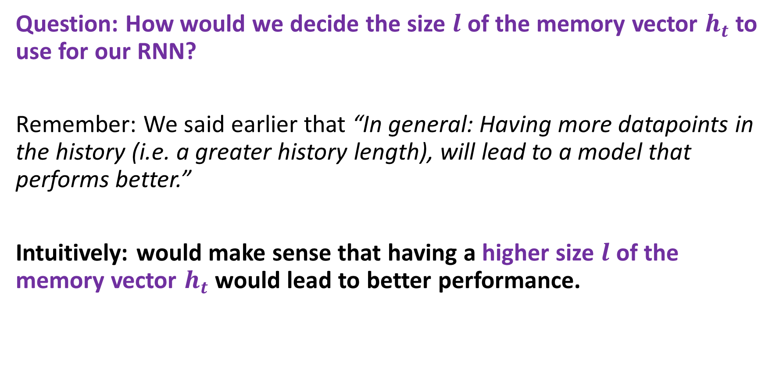
What is a good memory length then?
Question: How would we decide the size $l$ of the memory vector $h_{t}$ to use for our RNN?
Remember: We said earlier that “In general: Having more datapoints in the history (i.e. a greater history length), will lead to a model that performs better.”
Intuitively: would make sense that having a higher size $l$ of the memory vector $h_{t}$ would lead to better performance.

Slide 41
What is a good memory length then?
In practice,
Consider the time scale of the problem: The appropriate lookback length typically depends on the time scale of the problem you are trying to solve.
For example, if you are trying to predict daily stock prices, you might use a lookback length of 30 days.
If you are trying to predict hourly traffic patterns, you might use a lookback length of 24 hours.
(Typically, look at seasonality and trend of your data!)

Slide 42
What is a good memory length then?
In practice,
Balance model complexity with overfitting: Finding the optimal balance between model complexity and overfitting is a key consideration in choosing a lookback length.
A larger lookback length will capture more of the historical patterns and trends in the data, but it can also increase the complexity of the model and lead to overfitting.
A smaller lookback length may be simpler and less prone to overfitting, but it may also miss important patterns and trends in the data.

Slide 43
50.039 Theory and Practice of Deep Learning W6-S2 Times Series Data and Recurrent Neural Networks
Matthieu De Mari

Slide 45
The vanishing gradient problem is a common issue that can occur in recurrent neural networks (RNNs) during training. The problem arises when the gradients used to update the weights of the RNN become very small, making it difficult to propagate information over long time lags.
In RNNs, each hidden state is computed as a function of the previous hidden state and the current input. During training, the error signal is backpropagated through time to adjust the weights of the network. However, this backpropagation can result in very small gradients for the earlier time steps, since the gradients are multiplied by the Jacobian matrix of the recurrent connection at each time step.
When the gradients become very small, the weights of the network are updated very slowly, which can lead to slow convergence or even stagnation in the learning process. This can be particularly problematic for RNNs, since they are designed to handle time series data that can exhibit long-term dependencies.
The vanishing gradient problem can be particularly severe in RNNs that use activation functions that saturate, such as the hyperbolic tangent (tanh) or sigmoid functions. When the activation function saturates, the gradients become very small, making it difficult to propagate information through the network.
Several techniques have been developed to address the vanishing gradient problem in RNNs, such as using alternative activation functions, initializing the weights of the network carefully, or using specialized architectures like Long Short-Term Memory (LSTM) networks or Gated Recurrent Units (GRUs) that are designed to better handle long-term dependencies. These techniques can help to mitigate the vanishing gradient problem and improve the performance of RNNs on time series data.

Slide 46
Both Gated Recurrent Units (GRUs) and Long Short-Term Memory (LSTM) networks are advanced versions of the basic Recurrent Neural Network (RNN) architecture, designed to better handle long-term dependencies in time series data.
In contrast, GRUs use gating mechanisms to selectively update and discard information in the hidden state, which can help to maintain the gradients and avoid the vanishing gradient problem. This makes them better suited for modeling complex time series data that exhibit long-term dependencies or nonlinear patterns.
In summary, the benefits of using GRUs over a simple RNN architecture include better handling of long-term dependencies, avoidance of the vanishing gradient problem, and improved accuracy in time series prediction.

Slide 47
While both LSTM and GRU networks are effective at capturing long-term dependencies in time series data, there are some benefits to using LSTMs over GRUs in certain scenarios:
LSTMs are better suited for tasks that require long-term memory retention. LSTMs are designed to maintain and propagate information over longer time lags than GRUs. This makes them better suited for tasks that require the network to retain information for longer periods of time, such as language modeling or speech recognition.
LSTMs are more expressive and can model more complex functions than GRUs. LSTMs have more parameters than GRUs, which can make them more expressive and better able to model complex nonlinear functions. This can be beneficial in tasks that require a high level of accuracy, such as image or speech recognition.
LSTMs can handle variable-length input sequences more effectively. LSTMs can handle input sequences of variable lengths more effectively than GRUs, as they have an explicit memory cell that can store information over multiple timesteps. This can be useful in applications where the length of the input sequence may vary, such as natural language processing.

Slide 48
A sequence-to-sequence (seq2seq) model is a type of neural network architecture that is commonly used for tasks that involve processing variable-length input sequences and generating variable-length output sequences. Seq2seq models typically consist of two parts: an encoder that processes the input sequence and generates a fixed-length context vector, and a decoder that uses the context vector to generate the output sequence.
Seq2seq models are widely used in natural language processing tasks such as machine translation, text summarization, and conversational agents. Here are some examples of seq2seq models in NLP:
Machine translation: Seq2seq models are commonly used for machine translation tasks, where the input is a sequence of words in one language and the output is a sequence of words in another language. The encoder processes the input sequence of words and generates a context vector, which is then used by the decoder to generate the output sequence of words in the target language.
Text summarization: Seq2seq models can be used for text summarization tasks, where the input is a long document and the output is a summary of the document. The encoder processes the input document and generates a context vector, which is then used by the decoder to generate the summary.
Conversational agents: Seq2seq models can be used to build conversational agents, where the input is a sequence of messages from a user and the output is a sequence of responses from the agent. The encoder processes the input sequence of messages and generates a context vector, which is then used by the decoder to generate the response.
Speech recognition: Seq2seq models can also be used for speech recognition tasks, where the input is a sequence of audio samples and the output is a sequence of words. The encoder processes the audio samples and generates a context vector, which is then used by the decoder to generate the words.
Overall, seq2seq models have proven to be a powerful and flexible architecture for a wide range of natural language processing tasks, where the input and output sequences can have variable lengths and complex structures.

Slide 49
Conclusion (Week 6)
XXX
XXX

Slide 50
Learn more about these topics
Out of class, supporting papers, for those of you who are curious.
[XXX] XXX

Slide 51
Learn more about these topics
Tracking important names (Track their works and follow them on Scholar, Twitter, or whatever works for you!)
XX XX: XX at XX.

Slide 52
Learn more about these topics
Some extra (easy) reading and videos for those of you who are curious.
[XXX] XXX

